Slide 1
FORECASTING THE DAILY NUMBER OF CUSTOMERS IN RESTAURANT
Group : Aarati Sonawane
Smita Darashale

Slide 2
Goal:
Business Goal : how busy restaurant will be tomorrow.
Two day ahead forecasting
Forecasts will be used as:
→ mental preparation
→ daily job arrangement

Slide 3
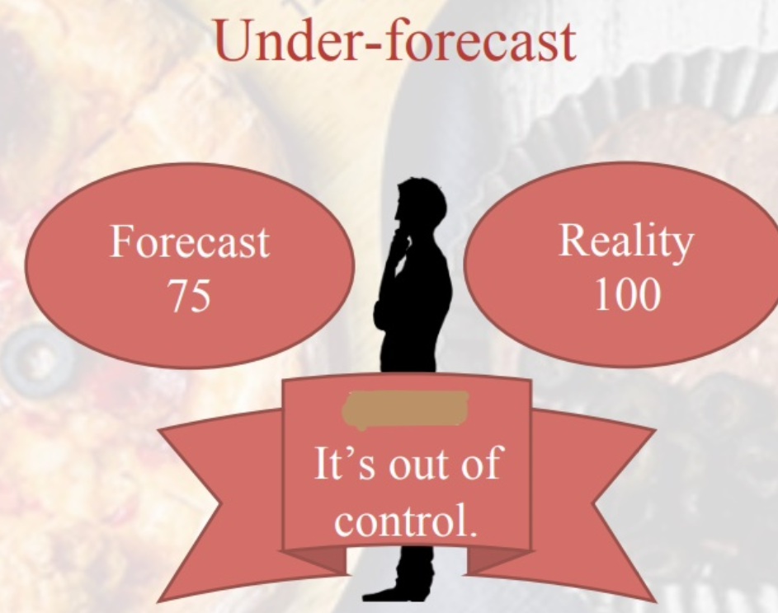
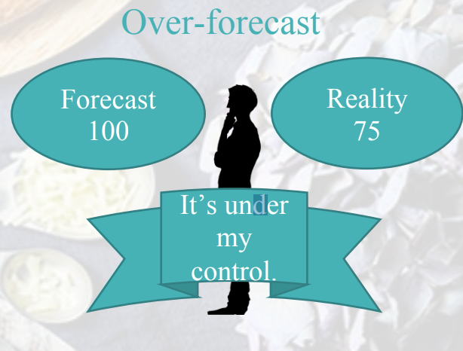
Forecasting Limitation:
Under-forecasted value Over-forecasted value
figure : 1 figure : 2
We prefer over-forecasting since it might not
increase manager’s pressure.

Slide 4
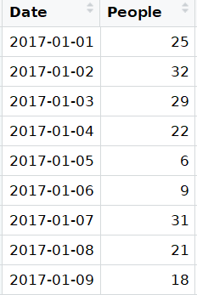
Data
Kaggle
Billing form to 2-column data
Frequency of collecting data: Daily
Data Sample:

Slide 5
ARIMA Model
Auto-Regressive Integrated Moving Average
Time series forecasting
Business application : forecasting future quantity
ex : Predicting the expected number of incoming customers
Explaining seasonal patterns in sales
weather forecasting
Packages : forecast, ggplot2, tseries

Slide 6
Steps:
Examine your data
Decompose your data
Stationarity
Autocorrelations and choosing model order
Fit an ARIMA model
Evaluate and iterate

Slide 7
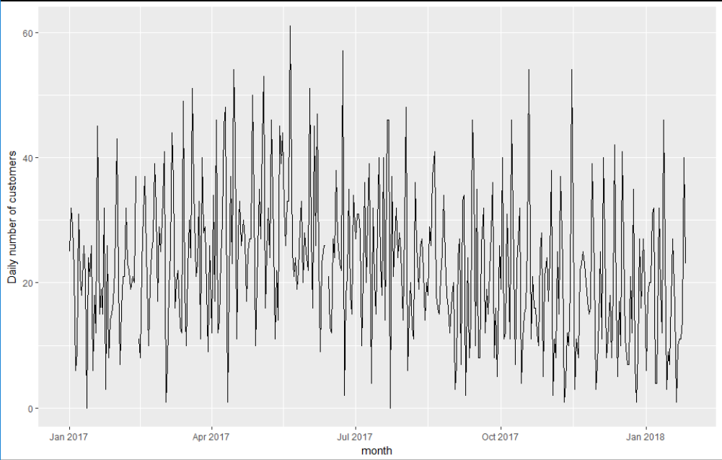
Step1: Examine Data
1.1: Plot the series : examine patterns and irregularities

Slide 8
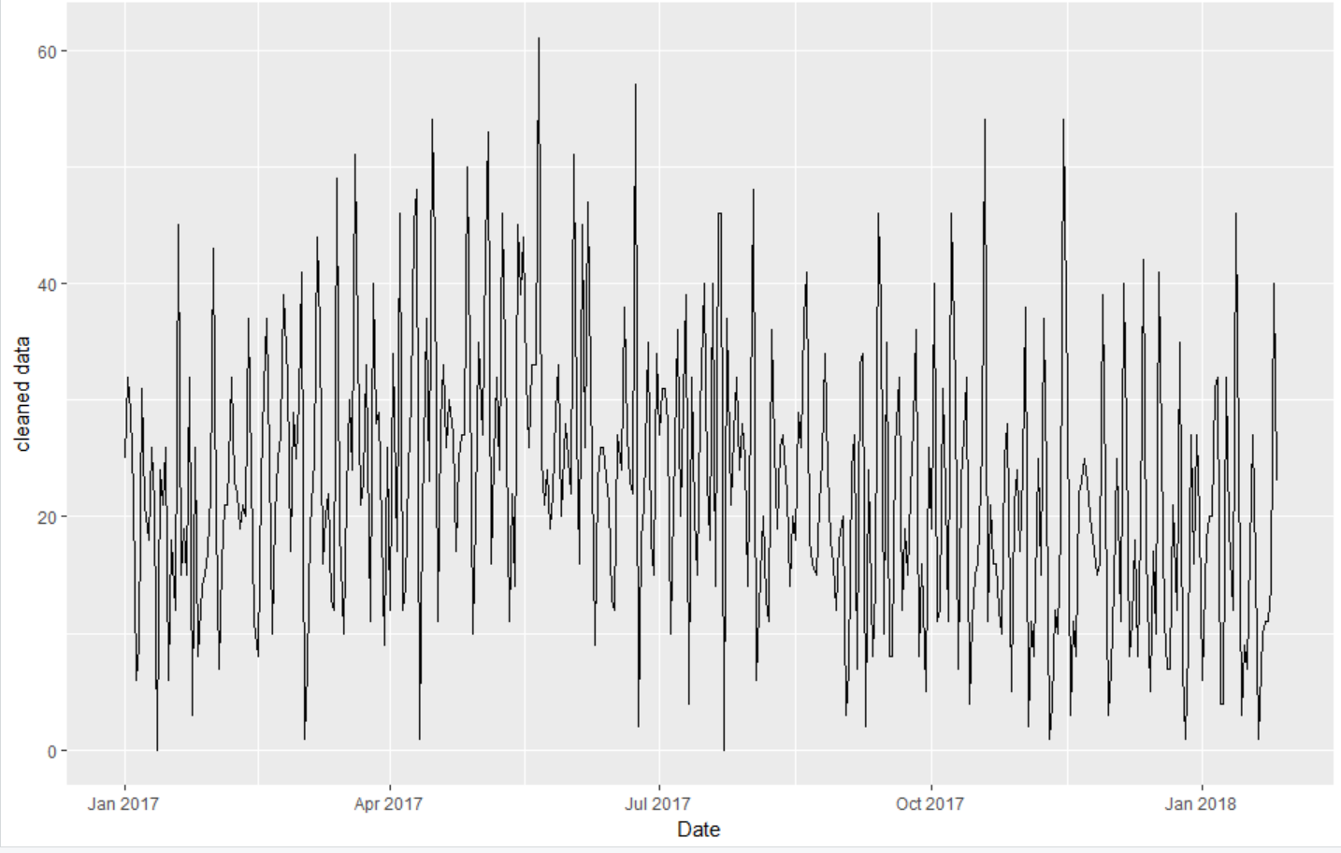
1.2: Plot the clean series:
Clean up any outliers or missing values if by tsclean()

Slide 9
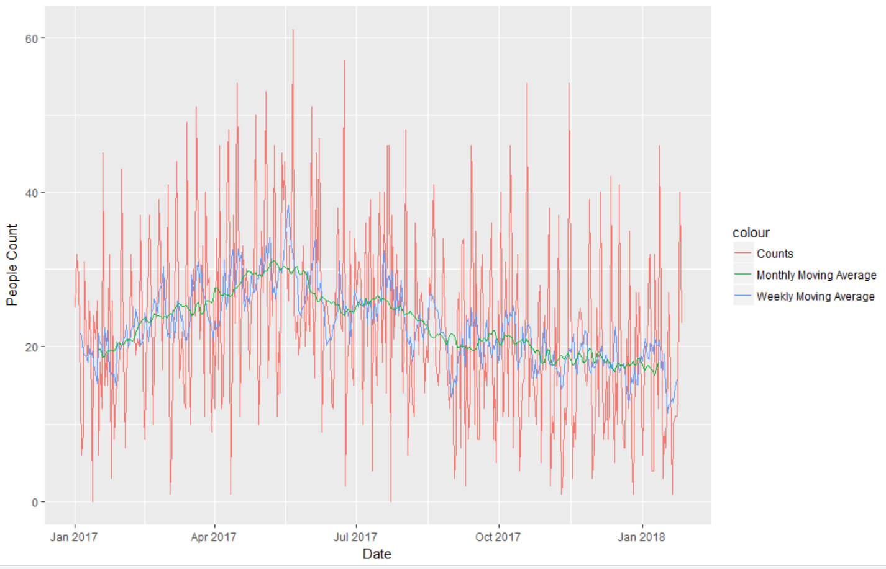
1.3: Smoothing series using moving average
smoothing the observed data into a more stable predictable series

Slide 10
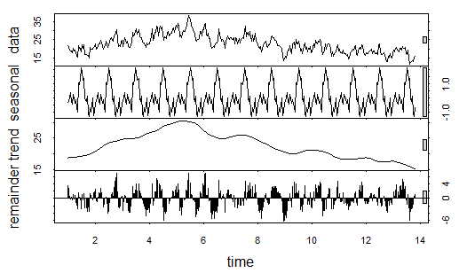
Step 2: Decompose data
Understand behavior(historical pattern)
Prepare foundation for forecasting model

Slide 11

Step 3: Stationary model
The augmented Dickey-Fuller Test:
Formal statistical test for stationarity.
Null hypothesis → Non-stationary Series

Slide 12

Step 4: Autocorrelations
Autocorrelation plots (ACF and PACF)
ARIMA(p,d,q)
ACF plot → order of MA(q)
PACF plot → order of AR(p)
Difference → d = 1

Slide 13
Step 5: Fitting an ARIMA model
auto.arima() - automatically generate a set of optimal (p, d, q) .
Combinations of order parameters
Picks the set that optimizes model fit criteria.

Slide 14
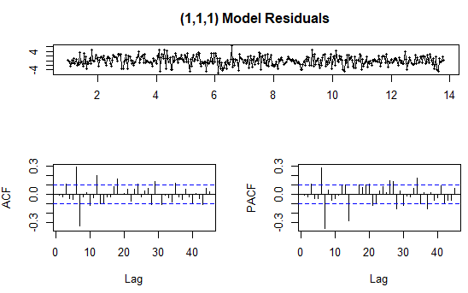
Step 6 : Evaluate and Iterate
Does this model make sense? Can we trust this model ?
Lets examine ACF and PACF plots for model residuals (expect no significant autocorrelations present).

Slide 15

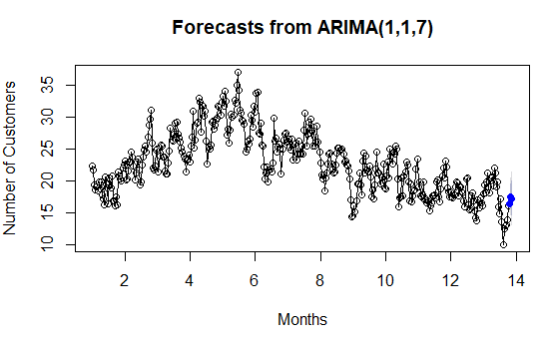
Result :

Slide 16
Thank you for your attention!

